Slide 1

Docker and Dockerhub: The Big Picture
Guillermo Gonzalez

Slide 2
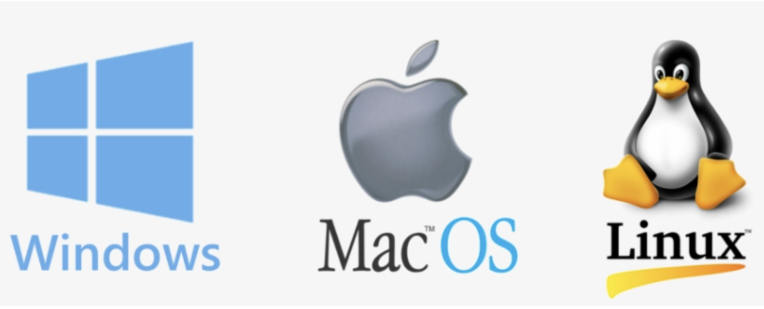
Operating Systems

Slide 3
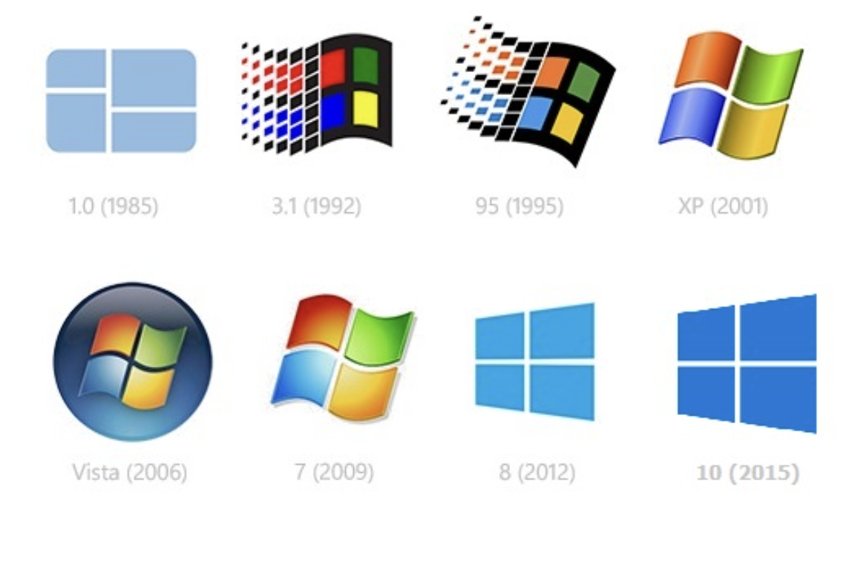
Windows

Slide 4
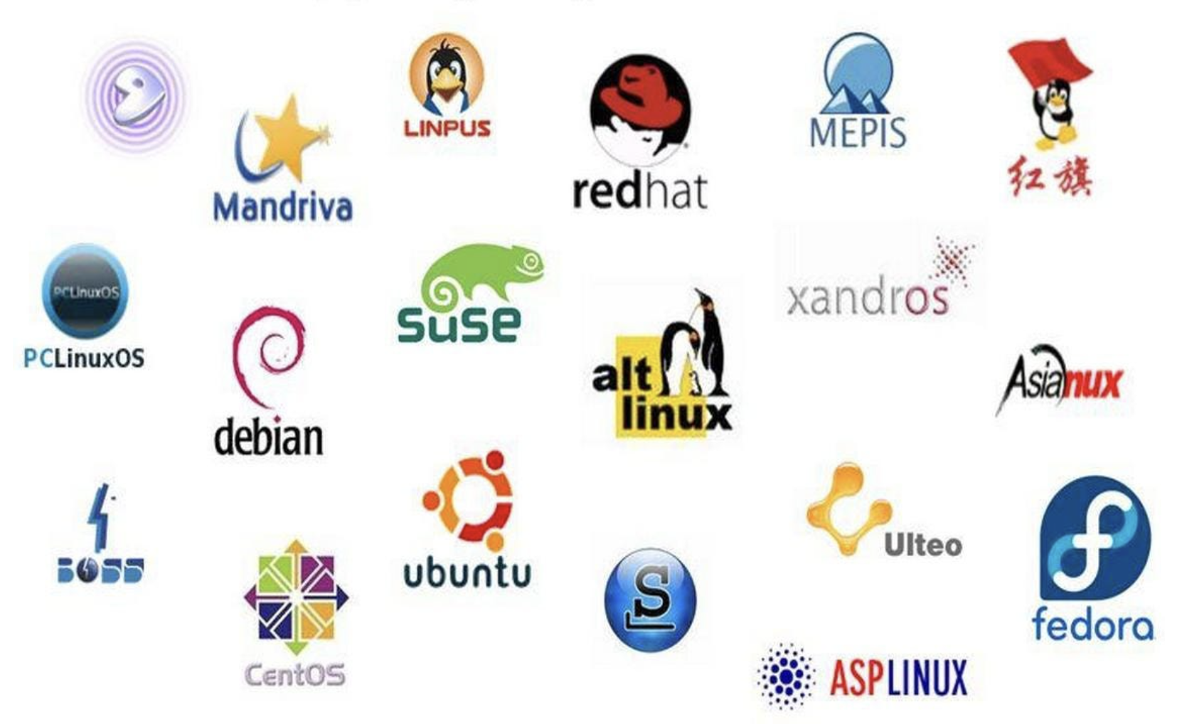
Linux

Slide 5
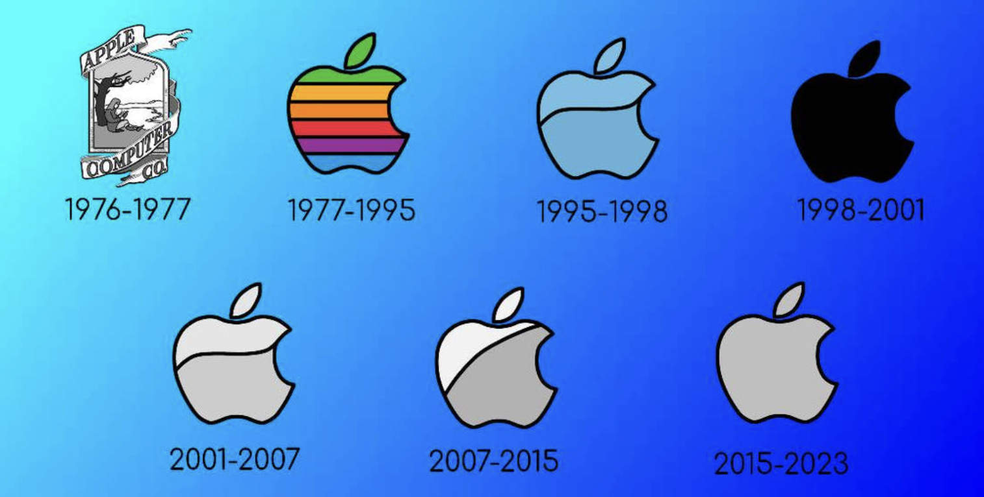
Mac OS

Slide 6
Package Managers
“A package manager … is a collection of software tools that automates the process of installing, upgrading, configuring, and removing computer programs for a computer's operating system in a consistent manner.”
-Wikipedia

Slide 7
History of package managers
Source / tarball from FTP / mailing lists
./configure
make
sudo make install
.deb or .rpm
YUP → YUM → DNF
dpkg → (deity) dselect → APT
https://opensource.com/article/18/7/evolution-package-managers

Slide 8
Examples of modern package managers
Windows Update
APT - Debian
YUM – RHEL/CentOS
Homebrew - macOS (+ Linux)
npm - Node.js
NuGet - .NET
pip - Python
anaconda
composer - PHP
Google Play – Android
Apple Store

Slide 9
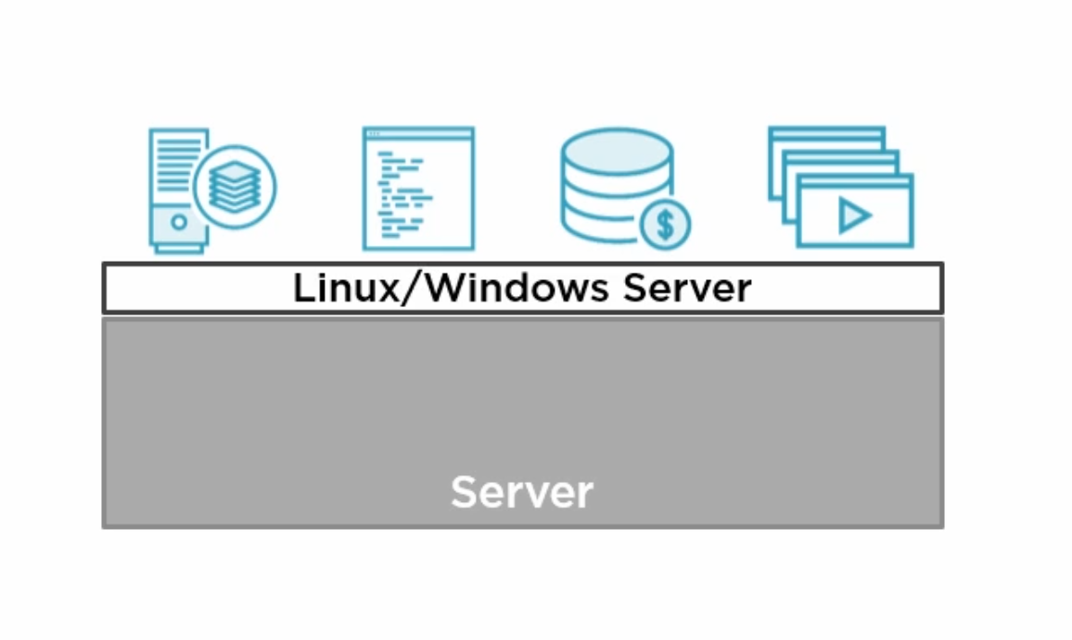
Servers

Slide 10
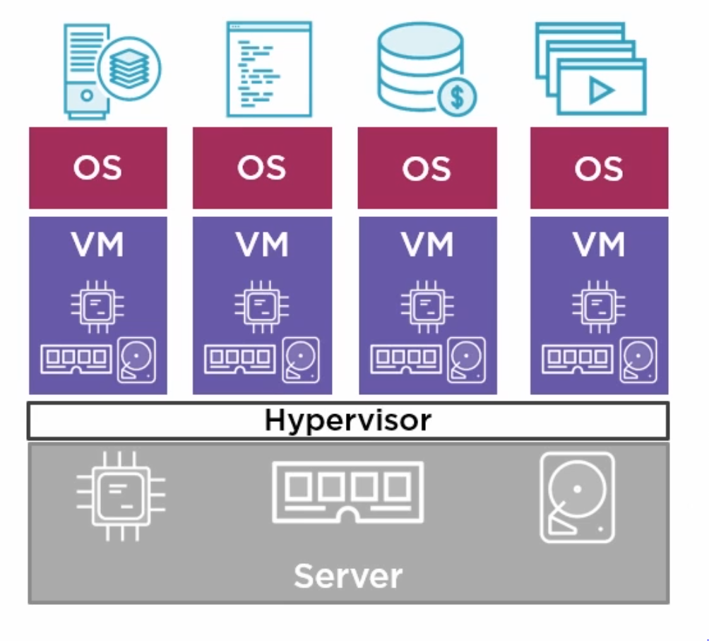
Virtual Machines

Slide 11
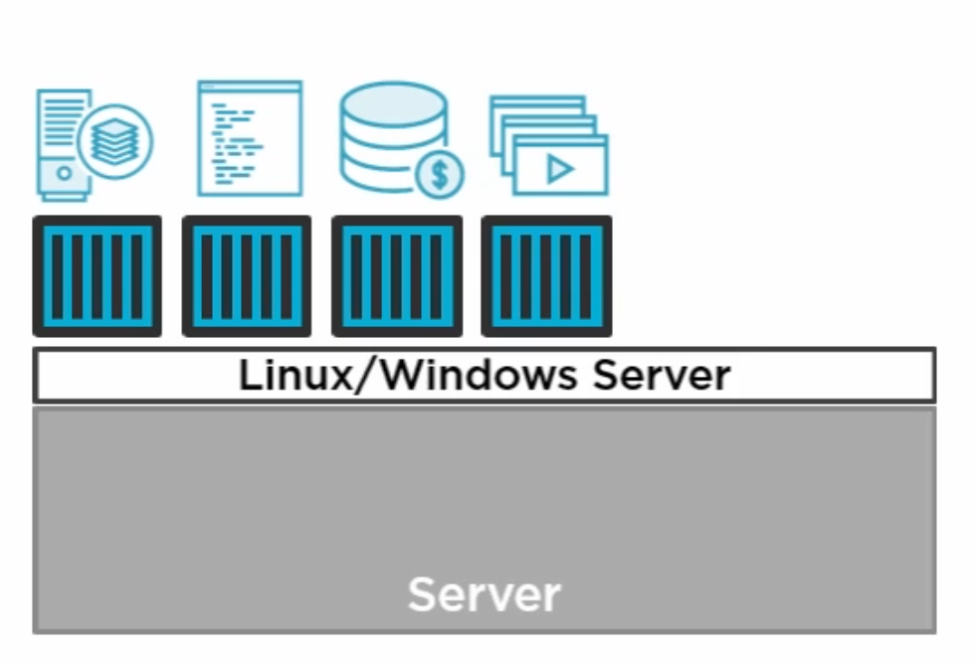
Containers

Slide 12
Winner?
Virtual Machines
Containers

Slide 13
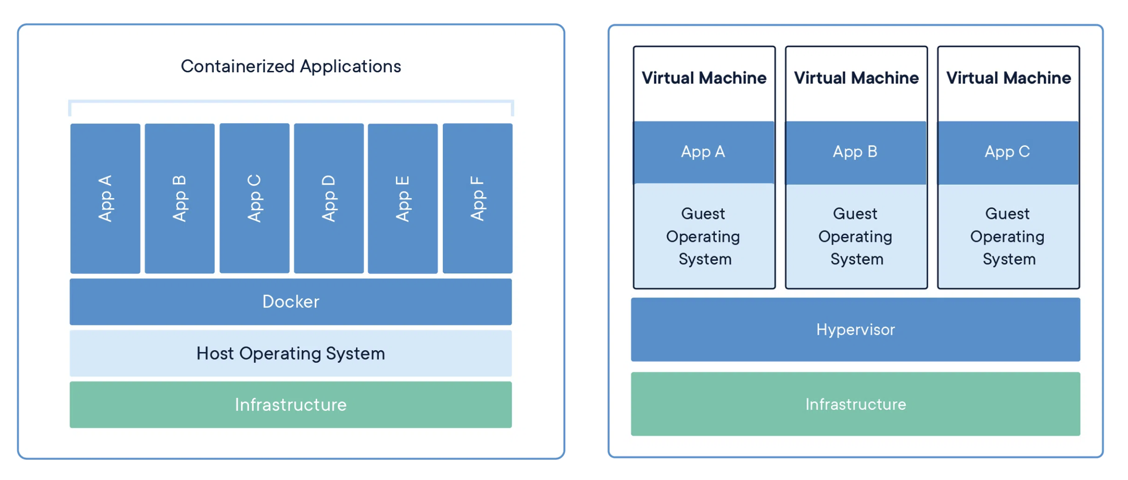

Slide 14
Dockerfile
It is a simple text file with a set of commands or instructions.
These commands/instructions are executed successively to perform actions on the base image to create a new docker image.
It will help you create custom Docker images.
Each instruction present in the docker file, represents a layer of the docker image.

Slide 15
Docker Images
A Docker image is made up of a collection of files that bundle together that are essential for the application.
It is read-only templates that you build from a set of instructions written in a Docker file.
The docker build command builds an image from a Dockerfile by reading the instructions from a Dockerfile.
Images define both what you want your packaged application and its dependencies to look like what processes to run when it’s launched.
Docker images act as a set of instructions to build a Docker container, like a template.

Slide 16
Docker Containers
Containers are the structural units of Docker, which are used to hold the entire package that is needed to run the application.
A Docker container is a virtualized run-time environment of the docker images.
In other words, we can say that the image is a template, and the container is the instance of the template.
These containers are compact, portable units in which you can start up an application quickly and easily.

Slide 17
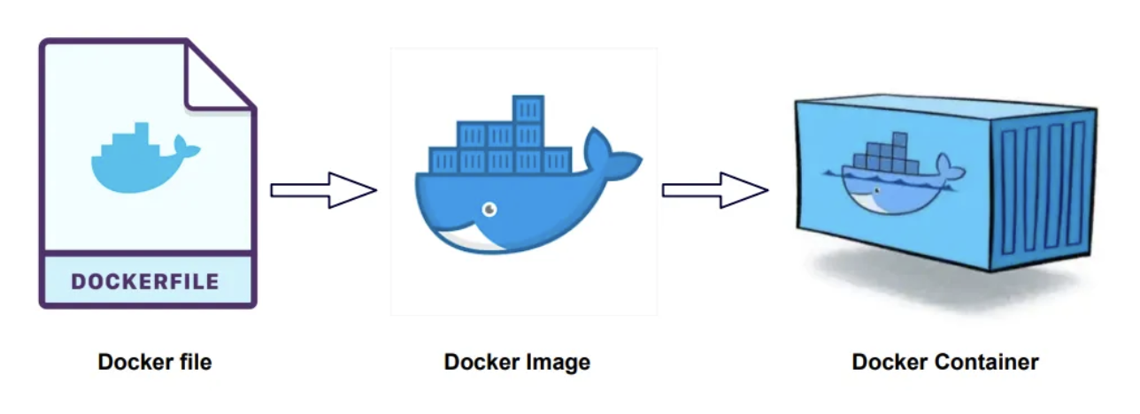
Containers vs Images

Slide 18
App.R
library(shiny)
ui <- fluidPage( titlePanel("Example Shiny Application") )
server <- function(input, output) { }
shinyApp(ui = ui, server = server)

Slide 19
Dockerfile
FROM rocker/shiny:4.1.0
RUN rm -rf /srv/shiny-server/*
WORKDIR /srv/shiny-server/
COPY ./app.R ./app.R

Slide 20
Build & Run the container
#build the image:
docker build -t shiny-in-docker .
#show the images:
docker images
#run the container:
docker run --rm -p 3838:3838 shiny-in-docker
#show running containers:
docker ps –a
#run the container in detached mode (background):
docker run –d –p 3838:3838 shiny-in-docker
#give a name to the container:
docker run –d --name shiny-4.1 –p 3838:3838 shiny-in-docker

Slide 21
Tutorials and Sandbox
https://www.docker.com/play-with-docker/

